Slide 1
SPECTRUM SENSING USING DEEP LEARNING
BY RACHEL UNDER THE GUIDANCE OF HENRY GIDDENS

Slide 2
Problem Statement
Crowded spectrum in wireless communication leads to interference and reduced data reliability.
Goal: Develop a deep learning model to classify radio signals in noisy environments.

Slide 3
Basic Introduction
Modulation
Types:
ANALOG MODULATION: AM, FM, PM
DIGITAL MODULATION: ASK, FSK, PSK, QAM (Combination of amplitude & phase)

Slide 4
Approach used
Dataset: RADIOML 2018.01A with 24 modulation types
Model: Hybrid CNN and ResNet architecture.
Feature extraction: Cumulants, spectral features, energy statistics to improve performance, especially in low SNR conditions.

Slide 5
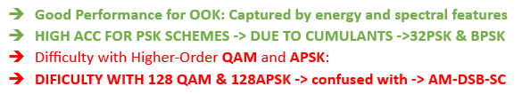
Classification Results

Slide 6
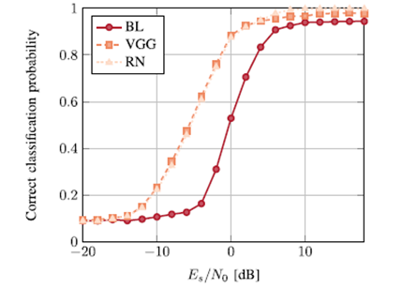
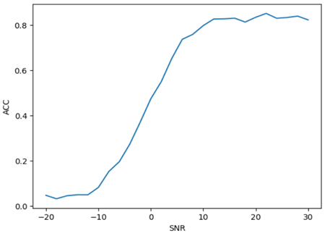
Models used in Research Paper
CNN-ResNet (Approach that I used)
The hybrid model outperforms the traditional baseline model
Accuracy increases rapidly around 80% almost similar to the two models used in first
Poor performance in low SNR

Slide 7
Limitations
Model performs poorly in low SNR conditions
Need to work on better feature extraction
Need more computing units

Slide 8
Thankyou

